Slide 1
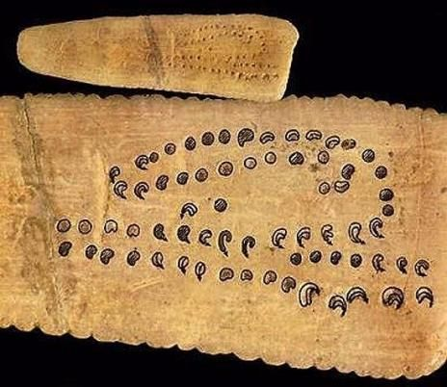
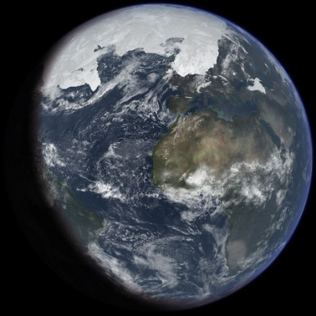
Astronomy is the Oldest Natural Science
c.32,000 BC: Aurignacian culture of Europe.
Bone carving of phases of the lunar cycle.

Slide 2
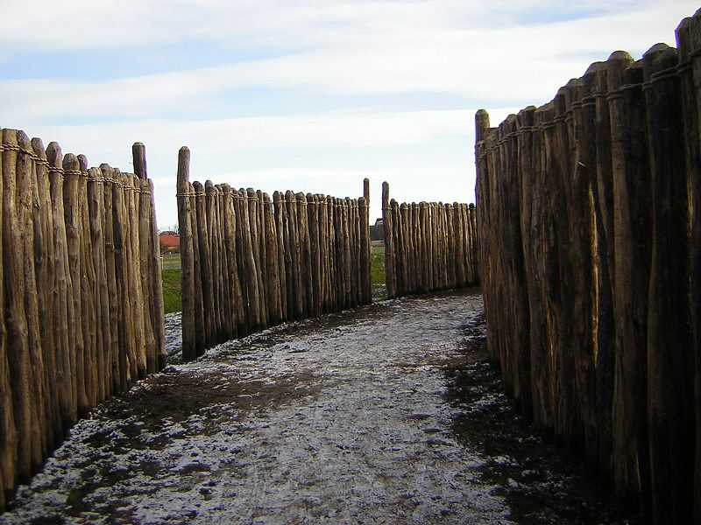
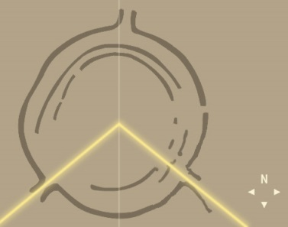
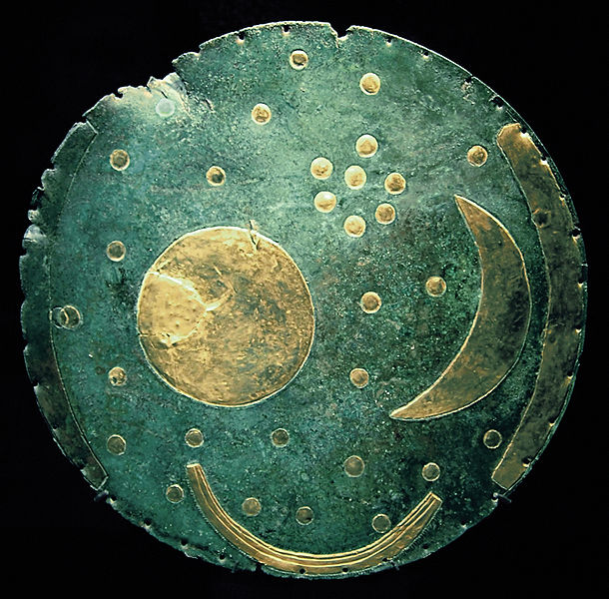
Astronomy is the Oldest Natural Science
Europe.
c.4900 BC: Goseck Henge, oldest known solstice observatory
c.1600 BC: Nebra Sky Disk,
Sun, Moon, Pleiades, etc.

Slide 3
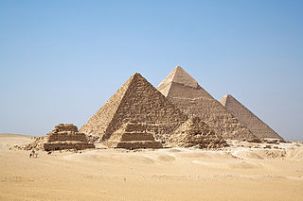
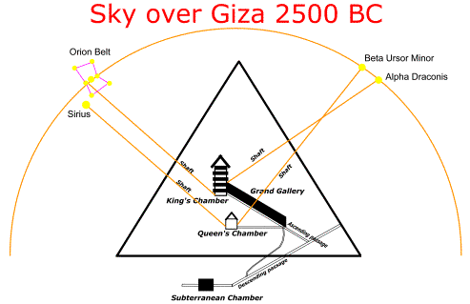
Astronomy is the Oldest Natural Science
Egypt
c.2600 BC: Pyramids at Giza, aligned with cardinal directions, Orion’s belt (“Osiris”—god of afterlife), then pole star, etc.

Slide 4
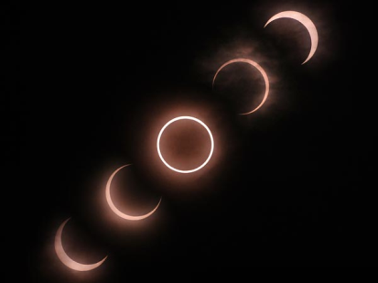
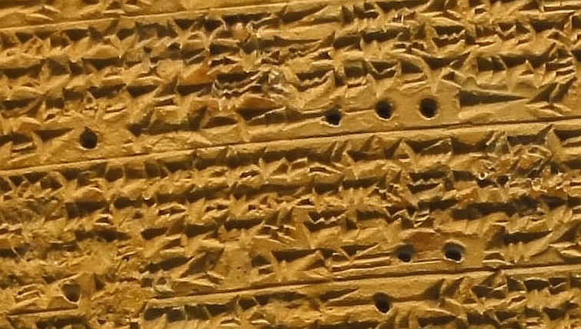
Astronomy is the Oldest Natural Science
Mesopotamia (Babylonians)
< 1200 BC: Detailed planet & eclipse observations, recog-nition of periodicity, application of math—base 60]

Slide 5
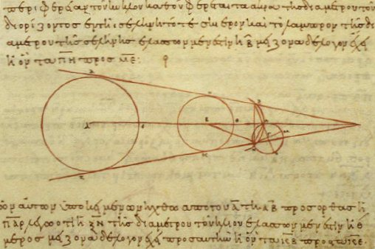
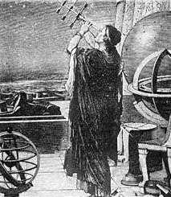
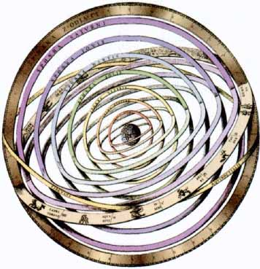
Astronomy is the Oldest Natural Science
Ancient Greeks
600 BC (Thales) – 100 AD (Ptolemy): Natural vs. supernatural explanations; Reasoning from observations; Sky is 3D; Detailed mathematical models of the cosmos.

Slide 6
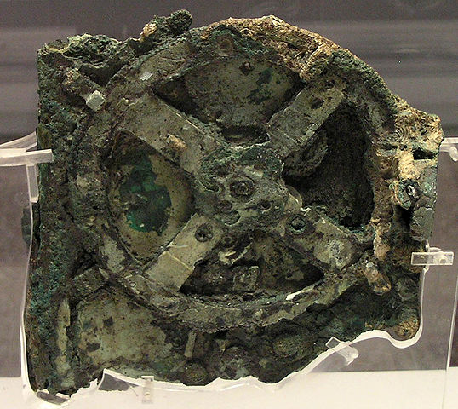
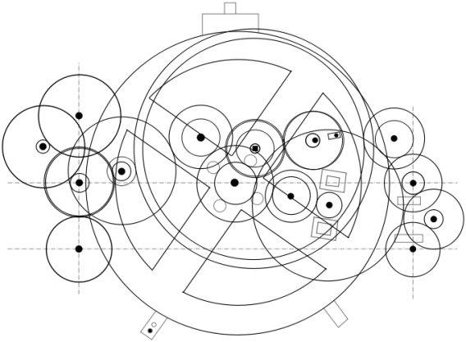
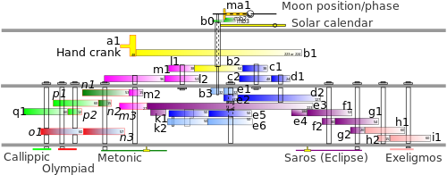
Astronomy is the Oldest Natural Science
c.100 BC: Antikythera mechanism—Archimedes? Hipparchus?
“This device is just extraordinary, the only thing of its kind. The design is beautiful, the astronomy is exactly right. The way the mechanics are designed just makes your jaw drop. Whoever has done this has done it extremely carefully ... in terms of historic and scarcity value, I have to regard this mechanism as being more valuable than the Mona Lisa.”

Slide 7
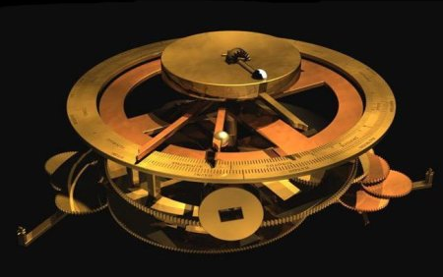
Astronomy is the Oldest Natural Science
c.100 BC: Antikythera mechanism—Archimedes? Hipparchus?

Slide 8
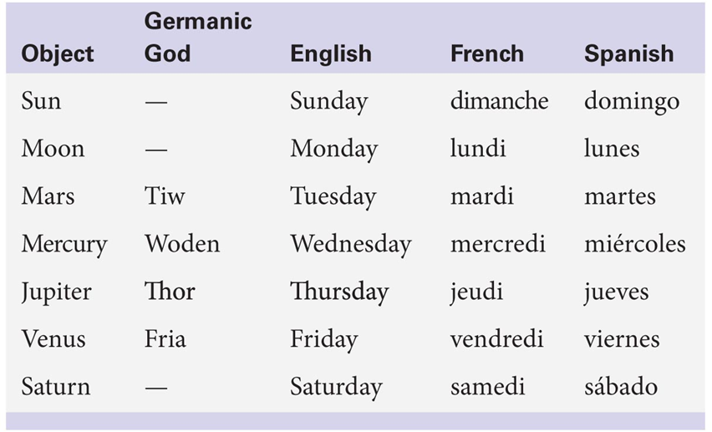
Astronomy is the Oldest Natural Science
Etc…….
Roughly: Babylonians → Greeks → Arabs → Europeans

Slide 9
Astronomy is the Oldest Natural Science
Note: Old astronomical records are invaluable!
Normally, things change in the sky so slowly that the timescale is >> than a person’s lifetime

Slide 10
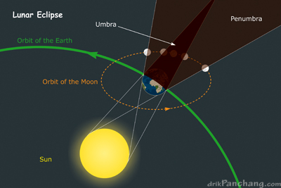
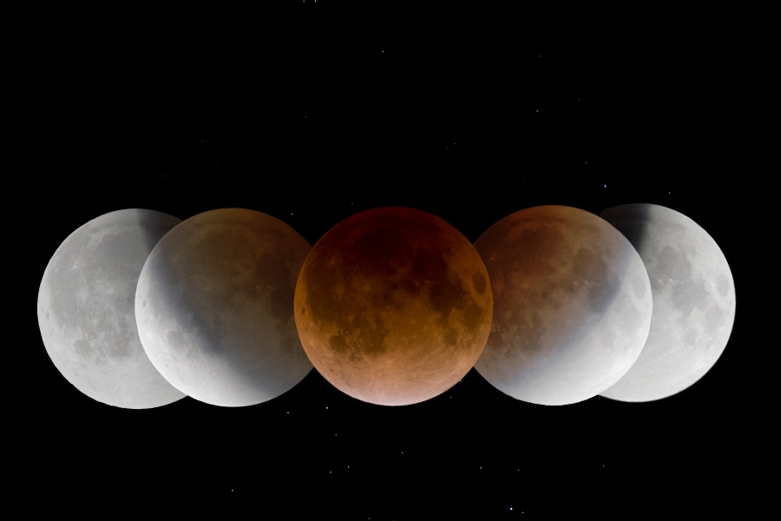
Greeks: Sky is Three-Dimensional
Immediately explains phases of Moon & eclipses (lunar/solar).
Question: Shape of the Earth? (Pythagoras & Aristotle)
Question: Size of the Earth compared to the Moon?

Slide 11
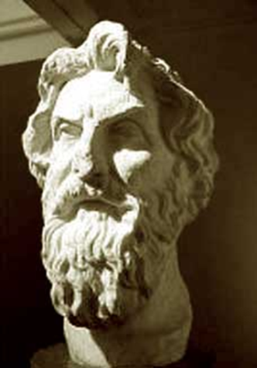
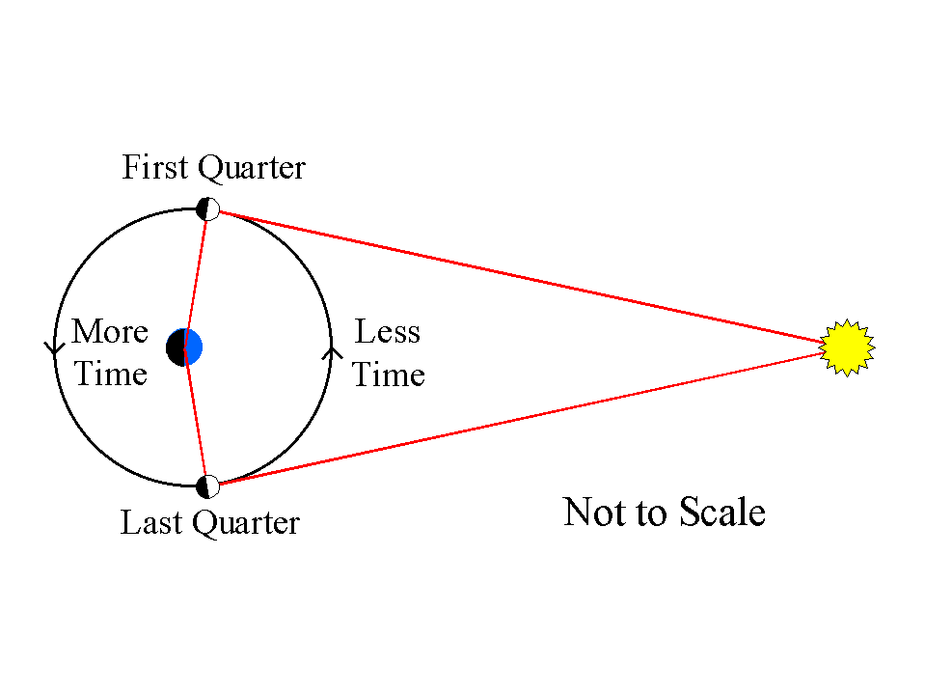
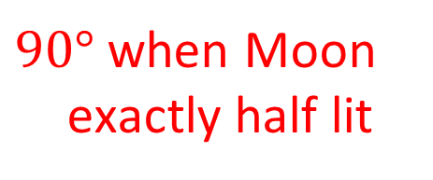



Aristarchus (c. 310-230 BC)
Calculated distance ratio:
(Earth-Sun) : (Earth-Moon)
$90°$ when Moon exactly half lit
$$B$$
$$θ$$
$$A$$
Measure time, T, from third quarter (bottom) to first quarter (top)
How?

Slide 12
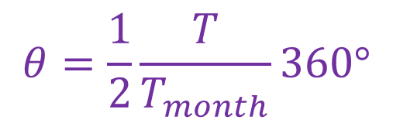

Aristarchus (c. 310-230 BC)
Calculated distance ratio:
(Earth-Sun) : (Earth-Moon)
$90°$ when Moon exactly half lit
$$B$$
$$θ$$
$$A$$
Measure time, T, from third quarter (bottom) to first quarter (top)
$$θ=\frac{1}{2}\frac{T}{T_{month}}360°$$
$$A=\frac{B}{\cos{θ}}=19B→390B$$

Slide 13


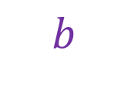
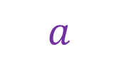
Aristarchus (c. 310-230 BC)
Calculated size ratio:
(Sun) : (Moon)
How?
$$B$$
$$a$$
$$b$$
$$A$$

Slide 14
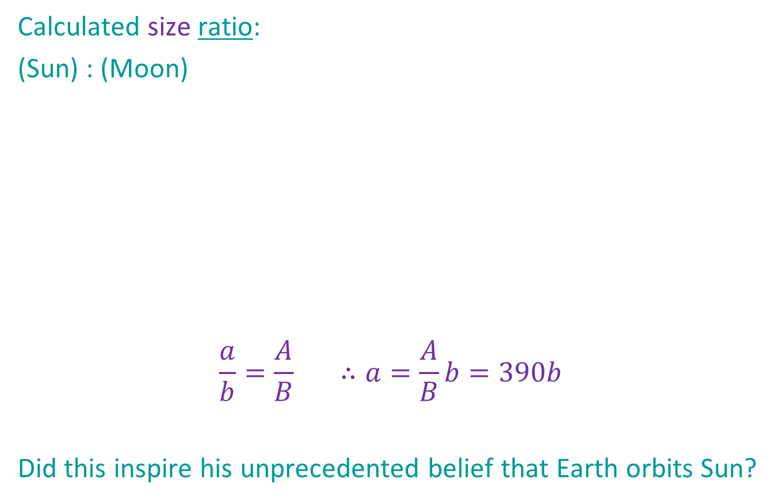
Aristarchus (c. 310-230 BC)
Calculated size ratio:
(Sun) : (Moon)
$$\frac{a}{b}=\frac{A}{B} ∴a=\frac{A}{B}b=390b$$
Did this inspire his unprecedented belief that Earth orbits Sun?
$$B$$
$$a$$
$$b$$
$$A$$

Slide 15
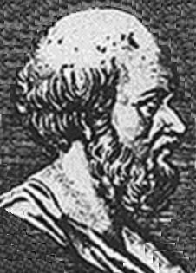
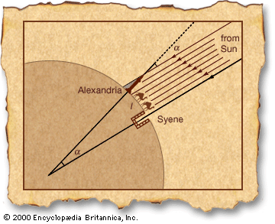
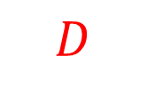
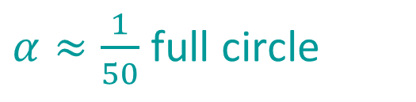
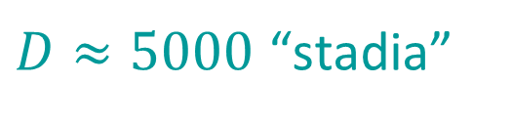

Eratosthenes (c. 276-196 BC)
Calculated absolute size of Earth
Measure:
Calculate Earth’s
circumference:
$α≈\frac{1}{50}$ full circle
$D≈5000$ “stadia”
$$D$$
$$C≈ ?$$

Slide 16


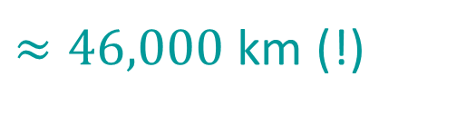
Eratosthenes (c. 276-196 BC)
Calculated absolute size of Earth
Measure:
Calculate Earth’s
circumference:
$α≈\frac{1}{50}$ full circle
$D≈5000$ “stadia”
$$D$$
$$C≈50×5000$$
$≈250,000$ stadia
$≈46,000$ km (!)

Slide 17
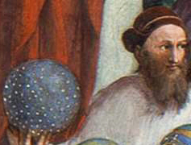
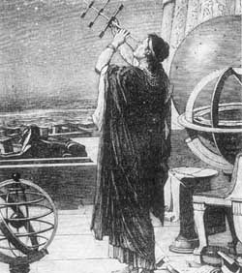
Hipparchus (c. 190-120 BC)
invented trigonometry
measured position and brightness of 850 stars – high precision, valuable today
celestial coordinate system, magnitude system
estimated Moon’s size and distance
measured length of year (to within 6 minutes of correct value!)
first reliable eclipse predictions
discovered precession of the equinoxes

Slide 18
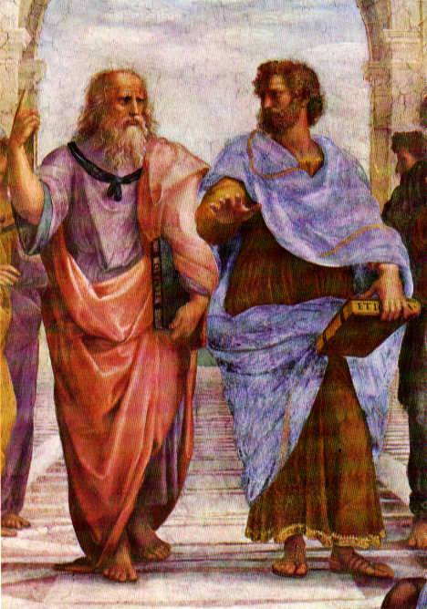
Aristotle (c. 384-322 BC)
Plato (c. 428-348 BC)
Argued forcefully in favour of Earth-centred universe
On what evidence might such an argument be based? Is this evidence valid?
Asserted all heavenly motions are:
in perfect circles
at constant speed
What are some problems with this?

Slide 19
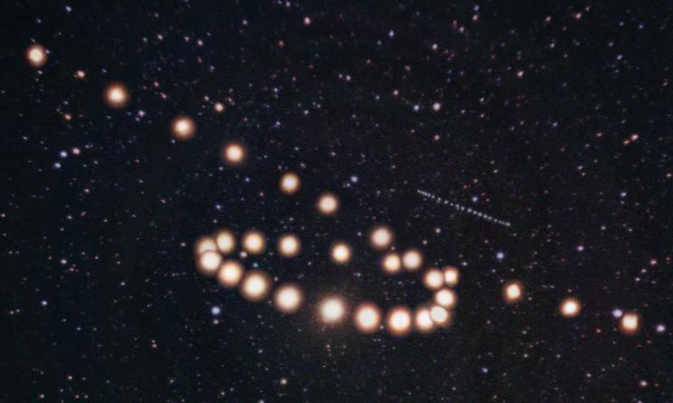
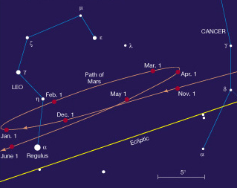
Central Problem of Ancient Astronomy
With these prejudices, how can one explain:
retrograde motion?
changing brightness?

Slide 20
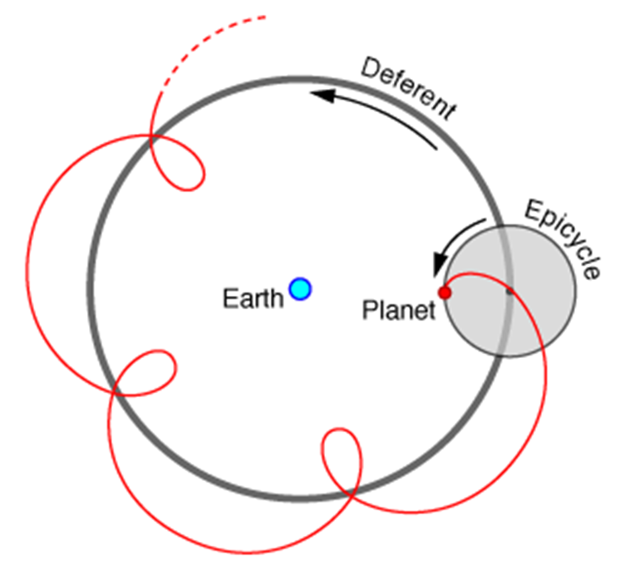
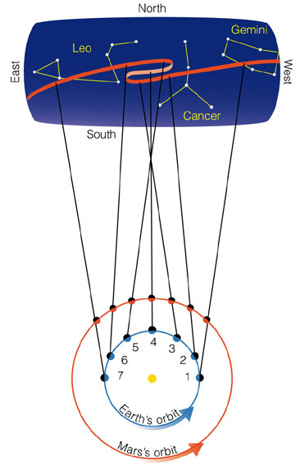
Answer in geocentric model →
Epicycles!
(Check: retrograde/brightness)
Animation
← Answer in heliocentric model:
Earth moves!
(Check: retrograde/brightness)
Earth orbits faster than Mars and overtakes it
Question: Why did ancient Greeks not accept the possibility that Earth moves?

Slide 21
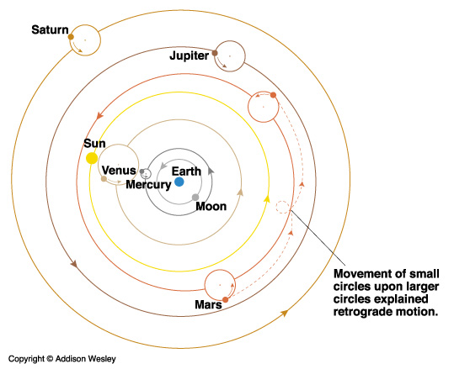

Slide 22
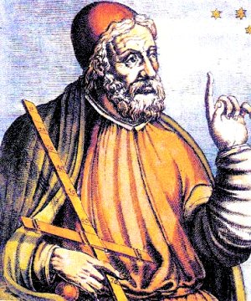
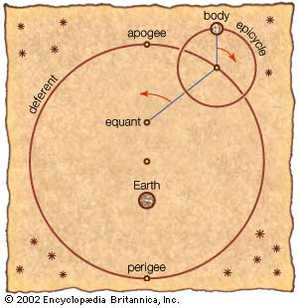
Ptolemy (c. 100-170 AD)
To improve the accuracy of the epicycle model, Ptolemy added:
Eccentric (displace Earth from centre of deferent circle)
Equant (constant angular speed seen from equant point)
…but varying physical speed
along deferent (‘sacrilege’!)
How does this better mimic true elliptical motion?

Slide 23
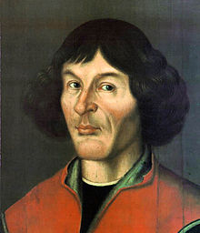
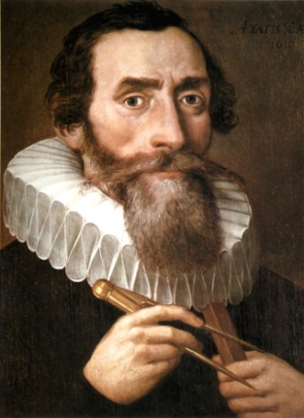
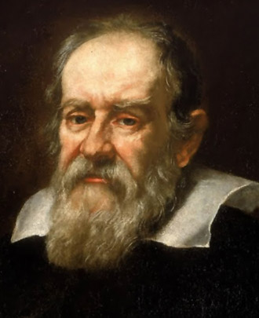
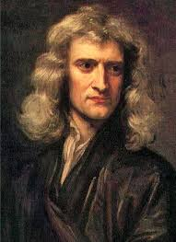
Ptolemy (c. 100-170 AD)
Ptolemy compiled all existing astronomical knowledge, plus his own innovations, into the Almagest, which was sufficiently accurate to dominate astronomy for 1500 years!
Eventually overthrown by Copernicus/Kepler/Galileo/Newton

Slide 24
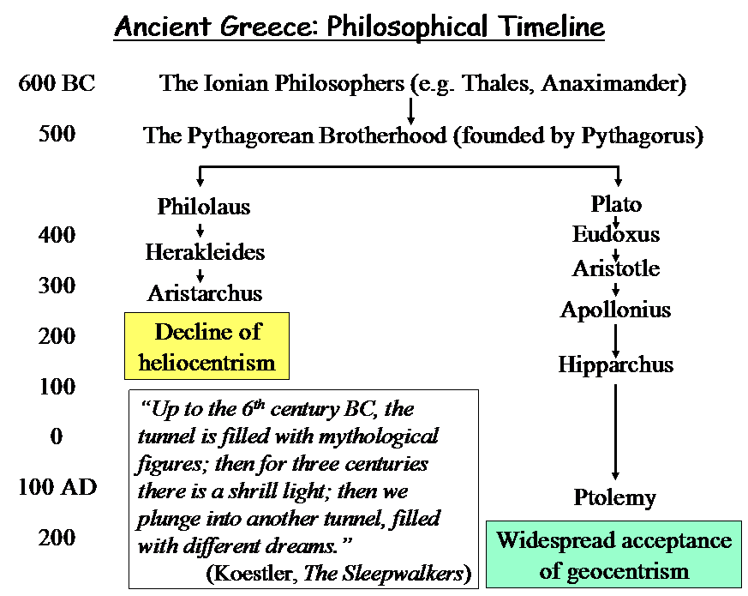
Summary of Ancient Greek Astronomy

Slide 25
Astronomy and Science
What does it mean to call an area of study a “science”?
observations of nature, record keeping
classification of properties
simple theories (“Occam’s Razor”)
communication of results, ideas, models
predictive powers
testing of predictions and discarding ideas that fail their tests
Scientists show only that models are wrong or flawed, not that they are right!

Slide 26
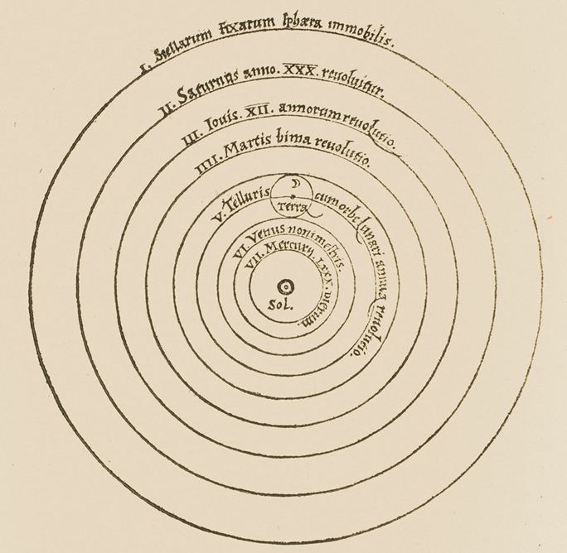
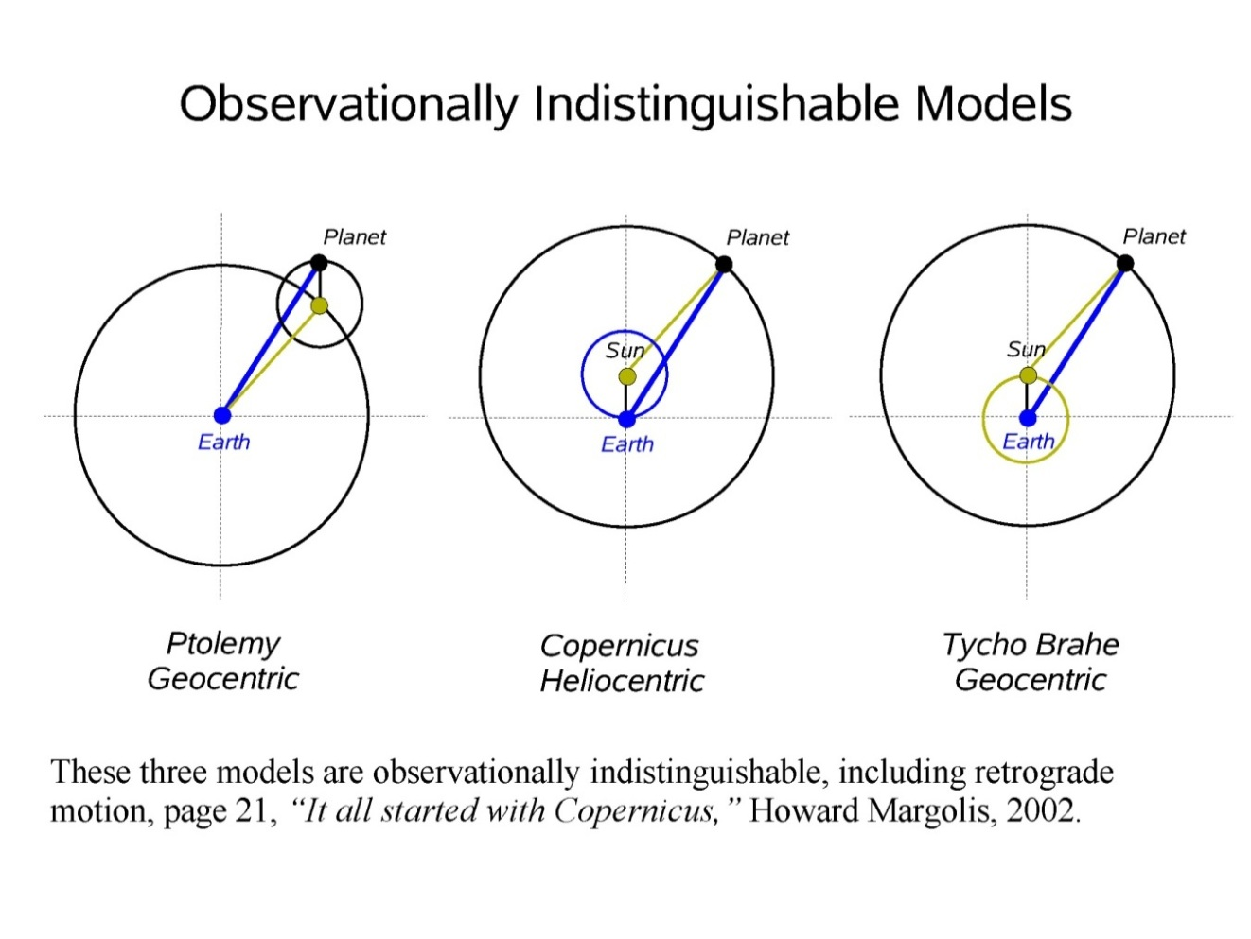
Copernicus (1473 – 1543)
Heliocentric model
Wasn’t looking for a revolution
Just simpler, more accurate model
Combine Ptolemy & Aristarchus?
Observationally indistinguishable; will simplicity of heliocentric model lead to more accurate predictions?
“In so many and such important ways, then, do the planets bear witness to the Earth’s mobility.”
Aristarchus

Slide 27
Copernicus (1473 – 1543)
“Last of the Ancients”
Wanted to remove Ptolemy’s ‘sacrilegious’ equant (non-uniform circular motion).
“the motion of heavenly bodies is uniform, eternal, and circular, or compounded of circular motions.”

Slide 28
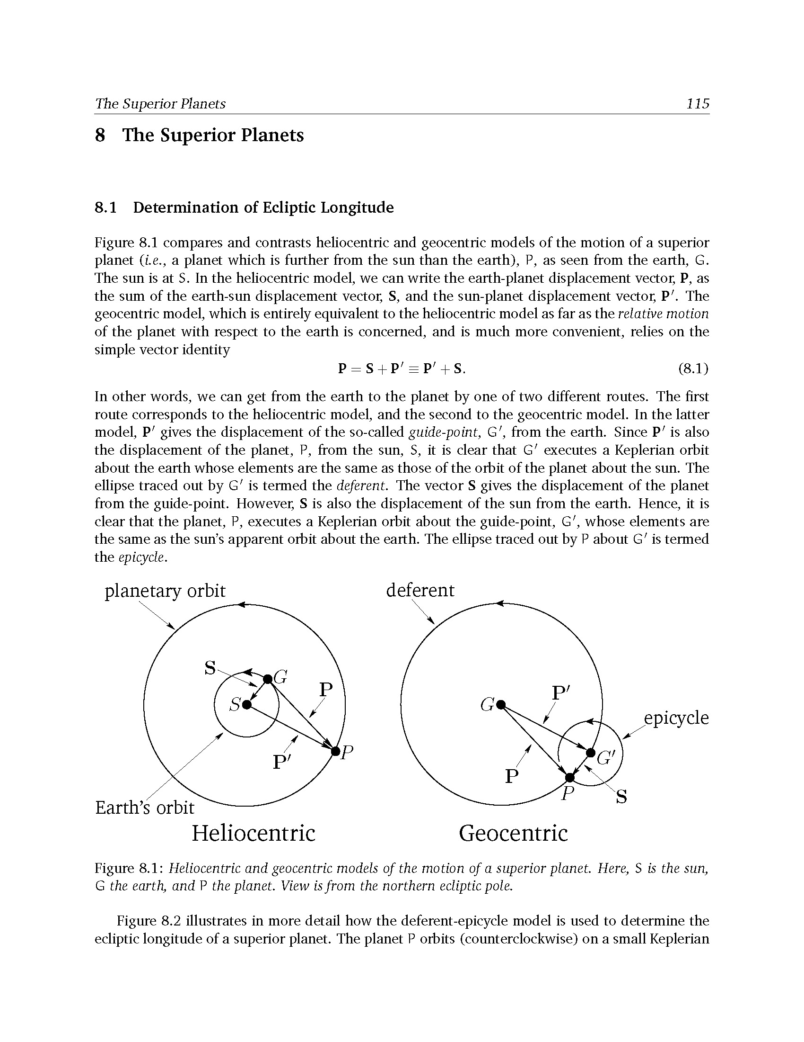


Copernican Model
Velocities add (fastest)
Velocities subtract (slowest)
Basic model. Now forget Earth―look at just P in circular orbit around S. This is a poor approxi-mation to real (elliptical) orbit.
Improved model:
eccentric: displace C from S [by (3/2)e]
epicycle rotating at twice deferent rate [of radius (1/2)e]

Slide 29
Copernican vs. Ptolemaic Models
Both have an eccentric (center of deferent circle is displaced from the Sun/Earth).
Copernican model avoids the ‘sacrilegious’ equant, but must make up for it with an epicycle.
Copernican model is actually less accurate than Ptolemaic model!

Slide 30

Copernican vs. Ptolemaic Models
Both models require epicycles on
epicycles for improved accuracy
“Then Mercury runs on seven circles in all; Venus on five; the Earth on three, and round it the Moon on four; finally Mars, Jupiter, and Saturn on five each. Altogether, therefore, thirty-four circles suffice to explain the entire structure of the universe and entire ballet of the planets.”
―Copernicus

Slide 31
Summary
Copernican model is:
not less complicated than Ptolemy’s model
not more accurate than Ptolemy’s model
Therefore, evidence for Earth’s motion is not strong!
Moreover, Copernican model required:
Earth not at centre of universe
Earth revolving and spinning
…both of which have physical & philosophical ‘problems’
Copernicus began a revolution, but it required Kepler, Galileo, and Newton to complete it!

Slide 32

One good thing about Copernican Model
In Ptolemaic model, angular data measured from Earth cannot determine the orbital radii of the planets (radii of deferent circles)…
…can determine only the ratio of radii: epicycle to deferent.

Slide 33



One good thing about Copernican Model
Key advantage of Copernican model is that it breaks this scale invariance. Angular data alone can determine:
planets’ orbital radii relative to Earth’s orbital radius (1 AU)
…and thus the correct order of the planets
Inferior Planet:
$$d$$
$$α$$

Slide 34



One good thing about Copernican Model
Key advantage of Copernican model is that it breaks this scale invariance. Angular data alone can determine:
planets’ orbital radii relative to Earth’s orbital radius (1 AU)
…and thus the correct order of the planets
Inferior Planet:
Measure $α$ at greatest elongation. Calculate distance from Sun to planet:
$$d(AU)=(1 AU)×sin⁡α$$
$$d$$
$$d$$
$$α$$
$$α$$

Slide 35



One good thing about Copernican Model
Key advantage of Copernican model is that it breaks this scale invariance. Angular data alone can determine:
planets’ orbital radii relative to Earth’s orbital radius (1 AU)
…and thus the correct order of the planets
Superior Planet:
$$α$$
$$d$$

Slide 36

One good thing about Copernican Model
Key advantage of Copernican model is that it breaks this scale invariance. Angular data alone can determine:
planets’ orbital radii relative to Earth’s orbital radius (1 AU)
…and thus the correct order of the planets
Superior Planet:
Measure time from opposition to quadrature. Based on previously measured sidereal periods of E and P, calculate
$$α=ESE^{′}−PSP′$$
$$d(AU)=\frac{1 AU}{\cos{α}}$$
$$α$$
$$d$$

Slide 37

One good thing about Copernican Model
Copernicus was thus able to construct first qualitatively correct model of the Solar System.
Notes:
Earth’s orbit = 1 AU

Slide 38


Tycho Brahe (1546 – 1601): Observations
Used large, carefully-built instruments of his own design → most accurate naked eye data in human history (one arcminute)

Slide 39


Tycho Brahe (1546 – 1601): Observations
Measured parallax of comet in 1577 → Comet was farther from Earth than the Moon…
...‘smashed’ ancient idea of crystalline celestial spheres.

Slide 40

Tycho Brahe (1546 – 1601): Observations
Measured no parallax of stars to one arcminute
Implies distance to stars > 1000 AU
A central Earth is more believable than stars that far away?!

Slide 41

Tycho Brahe (1546 – 1601): Observations
...so he invented his own hybrid geocentric model:
All 3 observationally indistinguishable
How is Tychonic model ‘best of both’?

Slide 42
Johannes Kepler (1571 – 1630): Analysis
Gifted mathematician & astronomer
Deeply religious. He believed:
God made the universe according to a
mathematical plan, which He had called
him to discover and reveal
Copernican model: Sun=Father, Stars=Son, Rest=Holy Spirit

Slide 43



Johannes Kepler (1571 – 1630): Analysis
Kepler’s first big “discovery”:
For each Platonic solid, inscribe and circumscribe it with spheres, getting a shell with thickness $∝$ radius
Nest the five shells in proper order and voila, out pops the correct relative radii of all the planets!

Slide 44

Johannes Kepler (1571 – 1630): Analysis
1596: Mysterium Cosmographicum Cosmic Mystery…which Contains the Secret of the Universe; on the Marvelous Proportion of the Celestial Spheres, and on the True and Particular Causes of the Number, Magnitude, and Periodic Motions of the Heavens; Established by Means of the Five Regular Geometric Solids
Book caught Tycho Brahe’s eye; Tycho took on Kepler as a student; gave Kepler his data on Mars

Slide 45



Physics Kepler knew:
Aristotle:
$v∝F$
Motion caused by consciousness (soul, intelligence, instinct)
Consciousness of heavenly bodies is serene, causing simple uniform circular motion (regular motion that can go indefinitely)
William Gilbert:
Theory of the magnetic soul of Earth
Magnetism, together with conscious-ness, causes planetary motions

Slide 46


Mathematics Kepler knew:
Archimedes:
Finding areas under curves using limits of inscribed and circumscribed polygons (inspired his nested Platonic solids…)
Nicholas of Cusa (1400s):
Equivalence, in the limit, of the straight line and circle of infinite radius, or the infinitesimal arc and its chord

Slide 47


Astronomy Kepler knew:
Ptolemy & Copernicus:
eccentric epicycle equant

Slide 48


Kepler’s Goals:
Perfect accuracy in reproducing observations
A unified model based on physical causes
ridiculous plausibly physical
“But whoever is too stupid to understand astronomical science, or too weak to believe Copernicus without affecting his faith, I will advise him that…he mind his own business and betake himself home to scratch his own dirt patch…”

Slide 49




Kepler’s “War with Mars”
Vicarious Hypothesis
Tried non-equal eccentric and equant: $f≠g$
Gave longitudes that fit Tycho’s data within 2’ error
…but wrong latitudes and distances

Slide 50

Kepler’s “War with Mars”
Vicarious Hypothesis
Tried equal eccentric and equant: $f=g$
Gave right distances
…but wrong latitudes (8’ error…unacceptable)
“If this wearisome method has filled you with loathing, it should more properly fill you with compassion for me, as I have gone through it at least 70 times...”

Slide 51


Kepler’s “War with Mars”
Completely overhauled Earth’s orbit
All data observed from Earth, but Earth’s orbit unknown
Unification: Best agreement with data if all planets have equal eccentric and equant (like foci of ellipse)
…but Kepler was still using circles with eccentric and equant (like Ptolemy), not ellipse.

Slide 52



Kepler’s “War with Mars”
Kepler’s “distance law”:
Noticed speed $v∝1/r$ at apsides (why?)
Thus time to traverse equal arcs: $∆t∝r$
Assumed (wrongly) $v∝1/r$ at all points on orbit
Justification (using wrong physics):
Planets are driven around by rotating “filaments” emanating from a rotating Sun, like spokes of a wheel
This magnetic-like “solar force” spreads out in a plane―hence diminishes as 1/𝑟 (vs. 1/𝑟^2)
Aristotle (wrong): $v∝F∝1/r$―it all made sense!

Slide 53


Kepler’s “War with Mars”
Kepler’s “area law”:
$v∝F∝\frac{1}{r} ⇒r \frac{dθ}{dt}∝\frac{1}{r} ⇒ dt∝r^{2}dθ ⇒∆t∝∆A$
Area law ≈ distance law; Kepler used the area law to simplify calculations, but still believed the distance law.
Computed longitudes of Mars using this area law (and ‘circle + eccentric + equant’); got errors as big as 8’
Realized only one possibility left:
orbit is not a circle!

Slide 54


Kepler’s “War with Mars”
Non-circular orbits:
Kepler then introduced an oval orbit, with epicyle driven by weird magnetic mechanism
“Area law” calculations with oval were too tedious, so he replaced the oval with an ellipse
But area law and ellipse were not true; …just approx. to simplify calculations!
After many more iterations, Kepler finally realized the area law and ellipse were true.

Slide 55

On Kepler’s Work
Kepler was also a mystic, which helped obscure the genius of his science.
“No doubt Kepler's discoveries were a kind of miracle of chance and love, and also of inventive hypothesizing and deductive logic”―Curtis Wilson

Slide 56


Kepler’s Laws of Planetary Motion
1st [Ellipse Law]:
Planets travel on elliptical orbits with the Sun at one focus.
2nd [Area Law]:
A line drawn from the Sun to a planet sweeps out equal areas in equal time intervals.
…revealed in Astronomia Nova (A New Astronomy) [1609]

Slide 57

Properties of an ellipse
semimajor axis is the average distance of a body from the orbit’s focus
an orbit’s focus is at the location of the centre of mass of the system

Slide 58
The shape of the Earth’s orbit (blue) and a circle with the same radius(black) as the semi-major axis.
SUN
Orbits to correct scale but Sun much too large!

Slide 59

Kepler’s Laws of Planetary Motion
3rd [Period Law]:
The squares of the sidereal orbital periods of the planets are proportional to the cubes of the semimajor axis of their orbits.
$$P^{2}=a^{3}$$
…revealed in Harmonices Mundi (Harmony of the World) [1619]
For objects orbiting the Sun, $P$ is in years and $a$ is in AU.
E.g. Mars: (1.88)² = (1.52)³

Slide 60

Galileo (1563 – 1642)
By experiment and reason he showed that the Earth could move.
Made the first telescope observations:
mountains on Moon
Sunspots
Milky Way is made of stars
moons of Jupiter
phases of Venus
These solidified the Copernican revolution

Slide 61

Galileo (1563 – 1642)
Observed:
Mountains and valleys on the Moon
Sunspots on the Sun
These “imperfections” challenged:
Ideological separation between heavens and Earth
Need for “perfect” uniform circular motion of heavenly bodies

Slide 62

Galileo (1563 – 1642)
Observed:
Milky Way is made of
innumerable, extremely
distant stars
This removed Tycho’s parallax objection to Earth’s motion:
If stars were much farther away, then lack of detectable parallax was no longer so troubling

Slide 63

Galileo (1563 – 1642)
Observed:
Moons of Jupiter
This undermined a key rationale for geocentric model
If Jupiter is a centre of motion, there must be multiple centres even in a geocentric model
Thus, multiple centres in a heliocentric model is more palatable

Slide 64

Galileo (1563 – 1642)
Observed:
phases of Venus
This was perhaps the most powerful blow against the Ptolemaic geocentric model.

Slide 65

Galileo (1563 – 1642)
Ptolemaic (geocentric) phases of Venus
Copernican (heliocentric) phases of Venus
Observed:
phases of Venus
This was perhaps the most powerful blow against the Ptolemaic geocentric model.

Slide 66
Summary of the Revolution
Copernicus:
Revived heliocentric model (simplest explanation of retrograde motion)
First qualitatively correct model of the Solar System (correct order and relative sizes of planetary orbits; still missing overall scale of Solar System)
Kepler:
Highly mathematical, but work also filled with mysticism and fanciful speculations
First to seriously attempt to bring physics into astronomy (“astrophysics”)
Three accurate laws (ellipse law, area law, period law) → shift away from Greek circles

Slide 67
Summary of the Revolution
Galileo:
Brought incontrovertible observational evidence (e.g., moons of Jupiter, phases of Venus)
Argued persuasively against old Aristotelian physics (a major obstacle to the revolution)
Laid the foundation for Newton’s work
But still need the genius of Newton to properly “unify the heavens and the Earth”…

